Slide 1
Hotel Rating Classification
TEAM 6
Mentor Name: R P Adhvaith

Slide 2

Business Problem
Business Objective:
The major objective is what are the attributes that travelers are considering while selecting a hotel. With this manager can understand which elements of their hotel influence more in forming a positive review or improves hotel brand image.

Slide 3
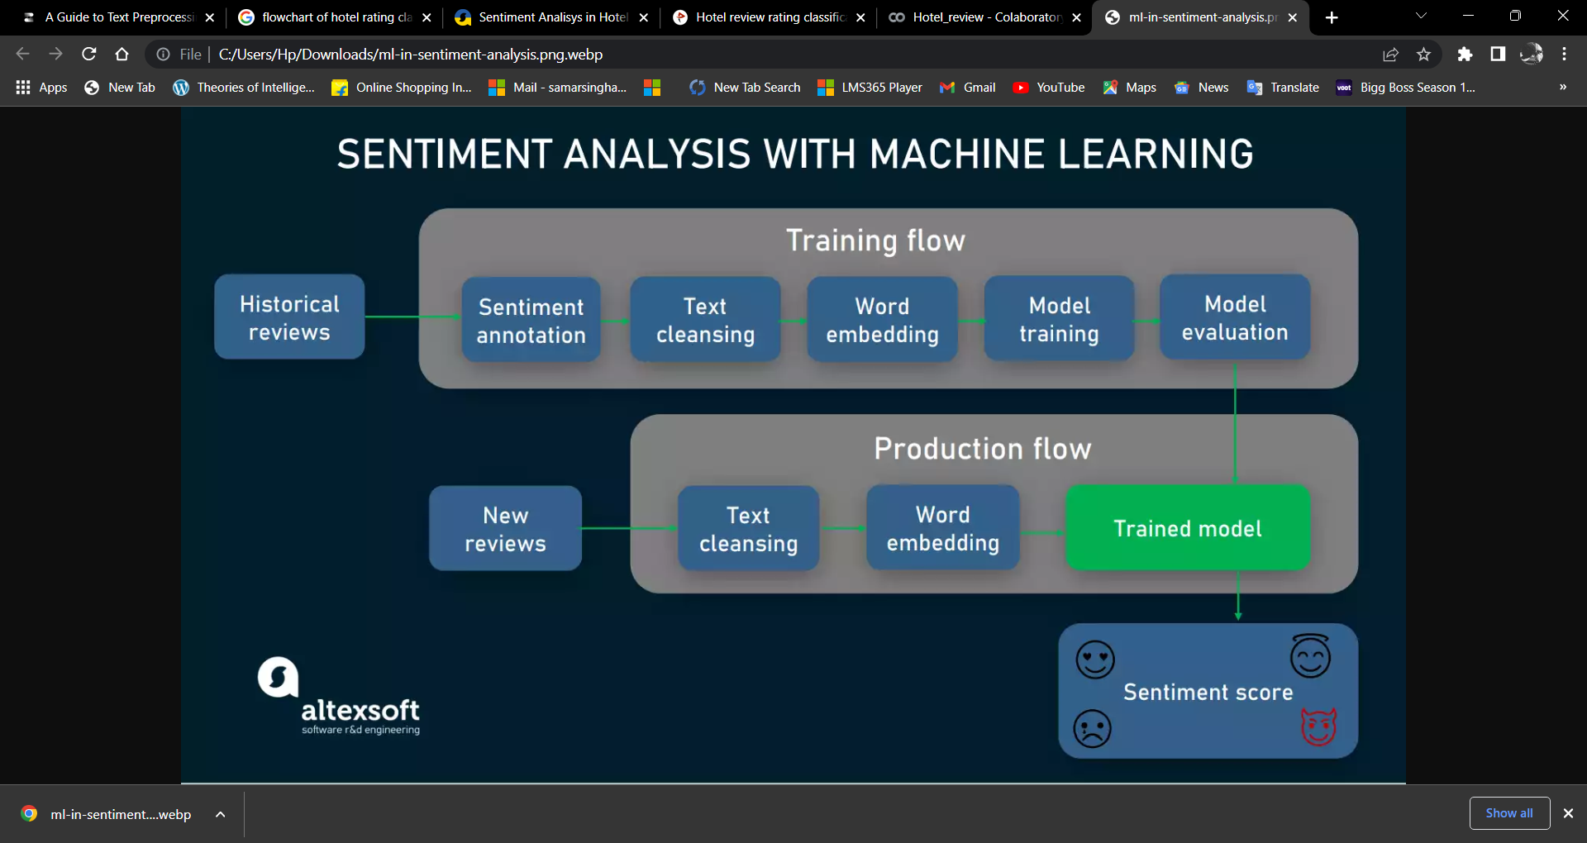
Project Architecture/Project Flow

Slide 4
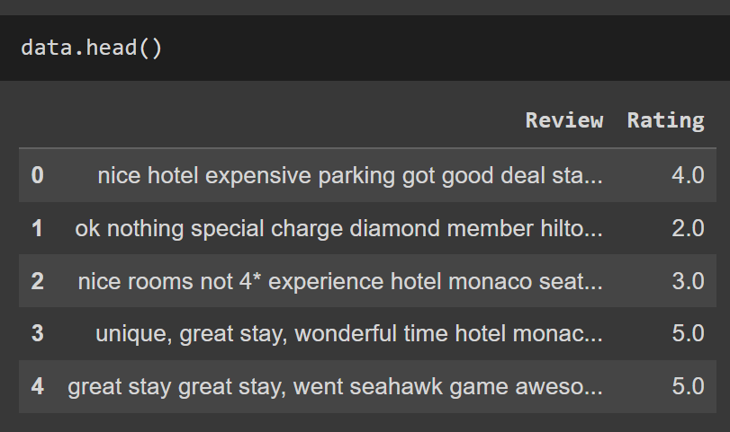
OVERVIEW OF THE DATASET
→ It is a Hotel Review Classification .
→The Dataset name is Hotel.xlsx.
→It consists of two columns.
→There are two Columns :
1.Reviews
2. Ratings.
→Ratings are given between 0 to 5
→No null values are present.
→No duplicate values are presents

Slide 5
Ratings

Slide 6
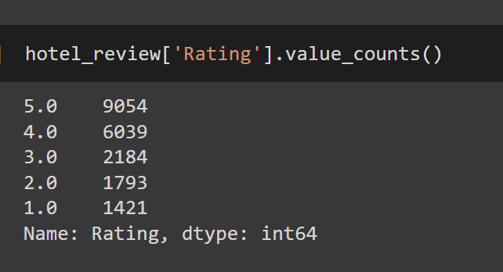
The Values counts of Rating are :

Slide 7
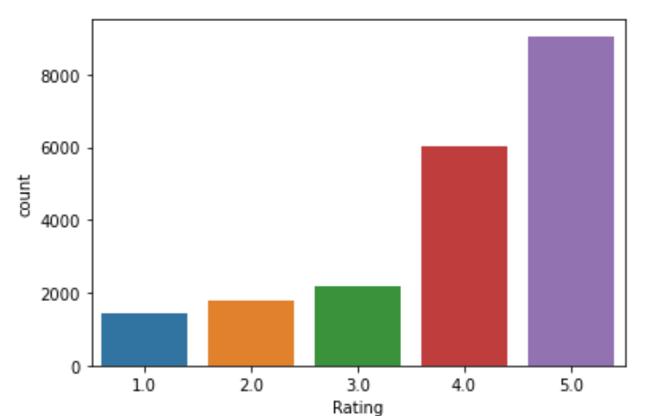

Slide 8
Reviews

Slide 9
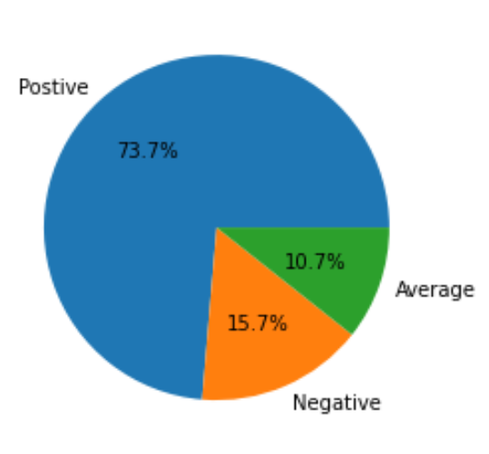
The dataset seems to be highly
imbalanced, this might turn out to be a problem in model building, we will have to take step which
can make the model balanced.
We try to form into three
types.
- 1.Negative : 1-2 Rating
- 2.Netural : 3 Rating
- 3.Positive : 4-5 Rating

Slide 10
Text-Pre Preprocessing

Slide 11
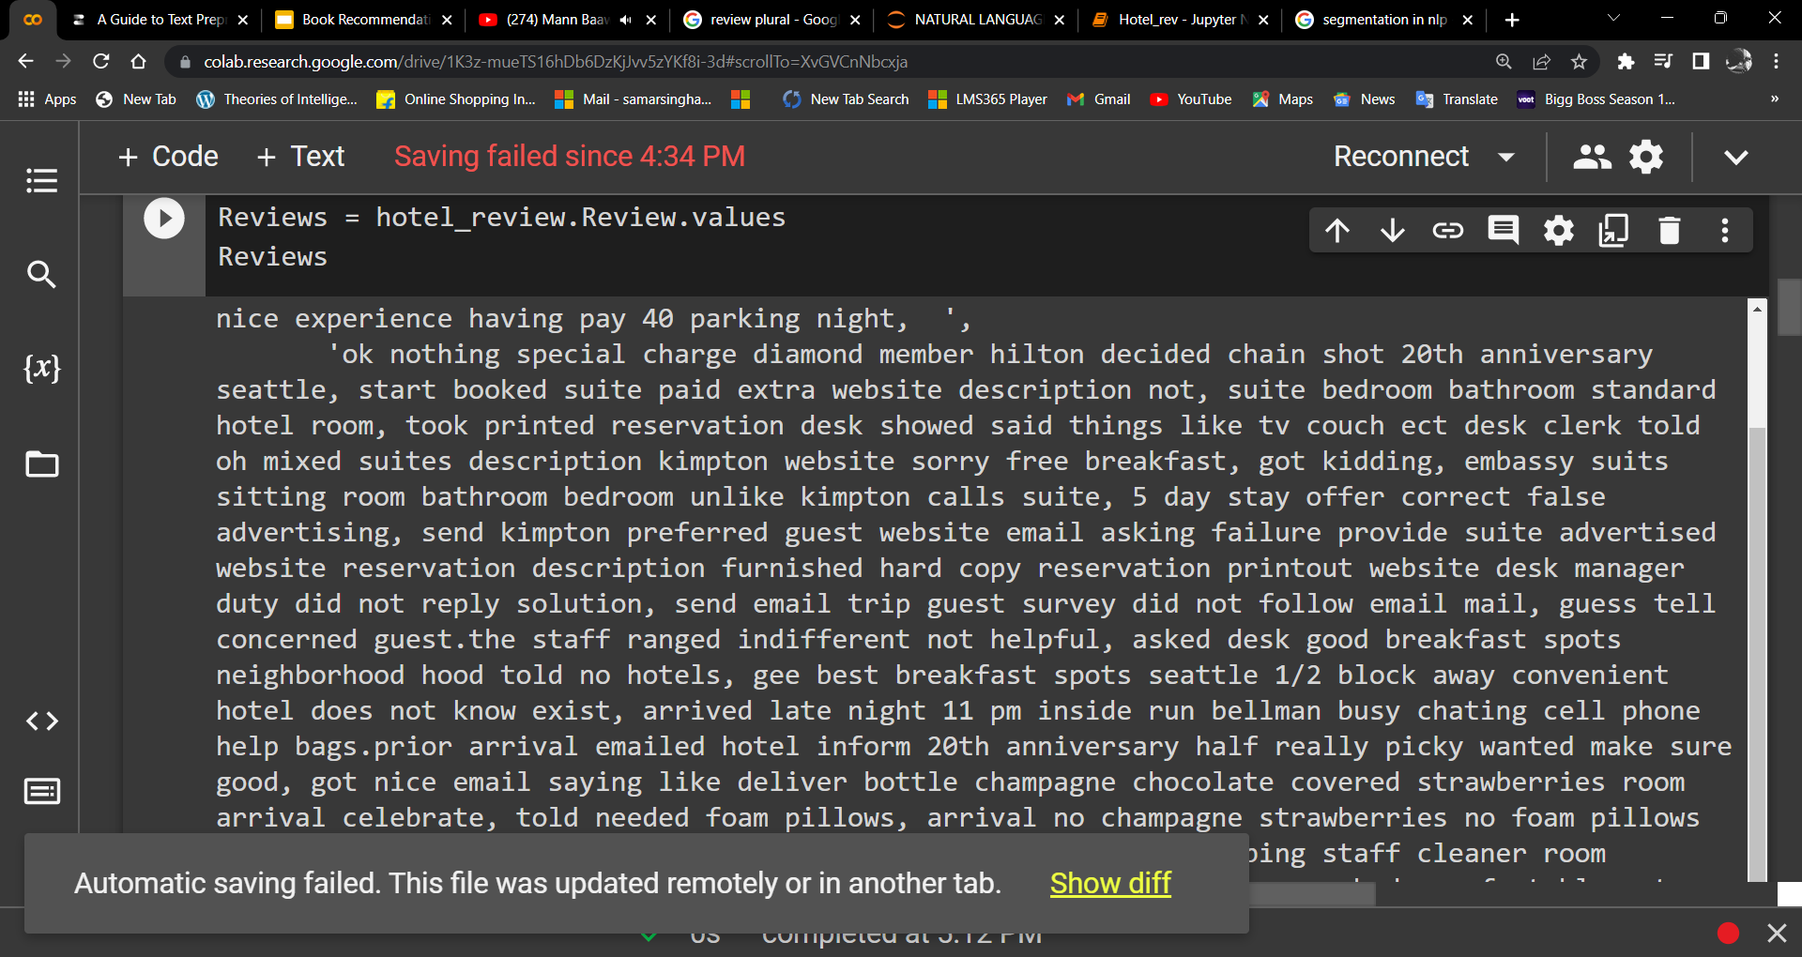
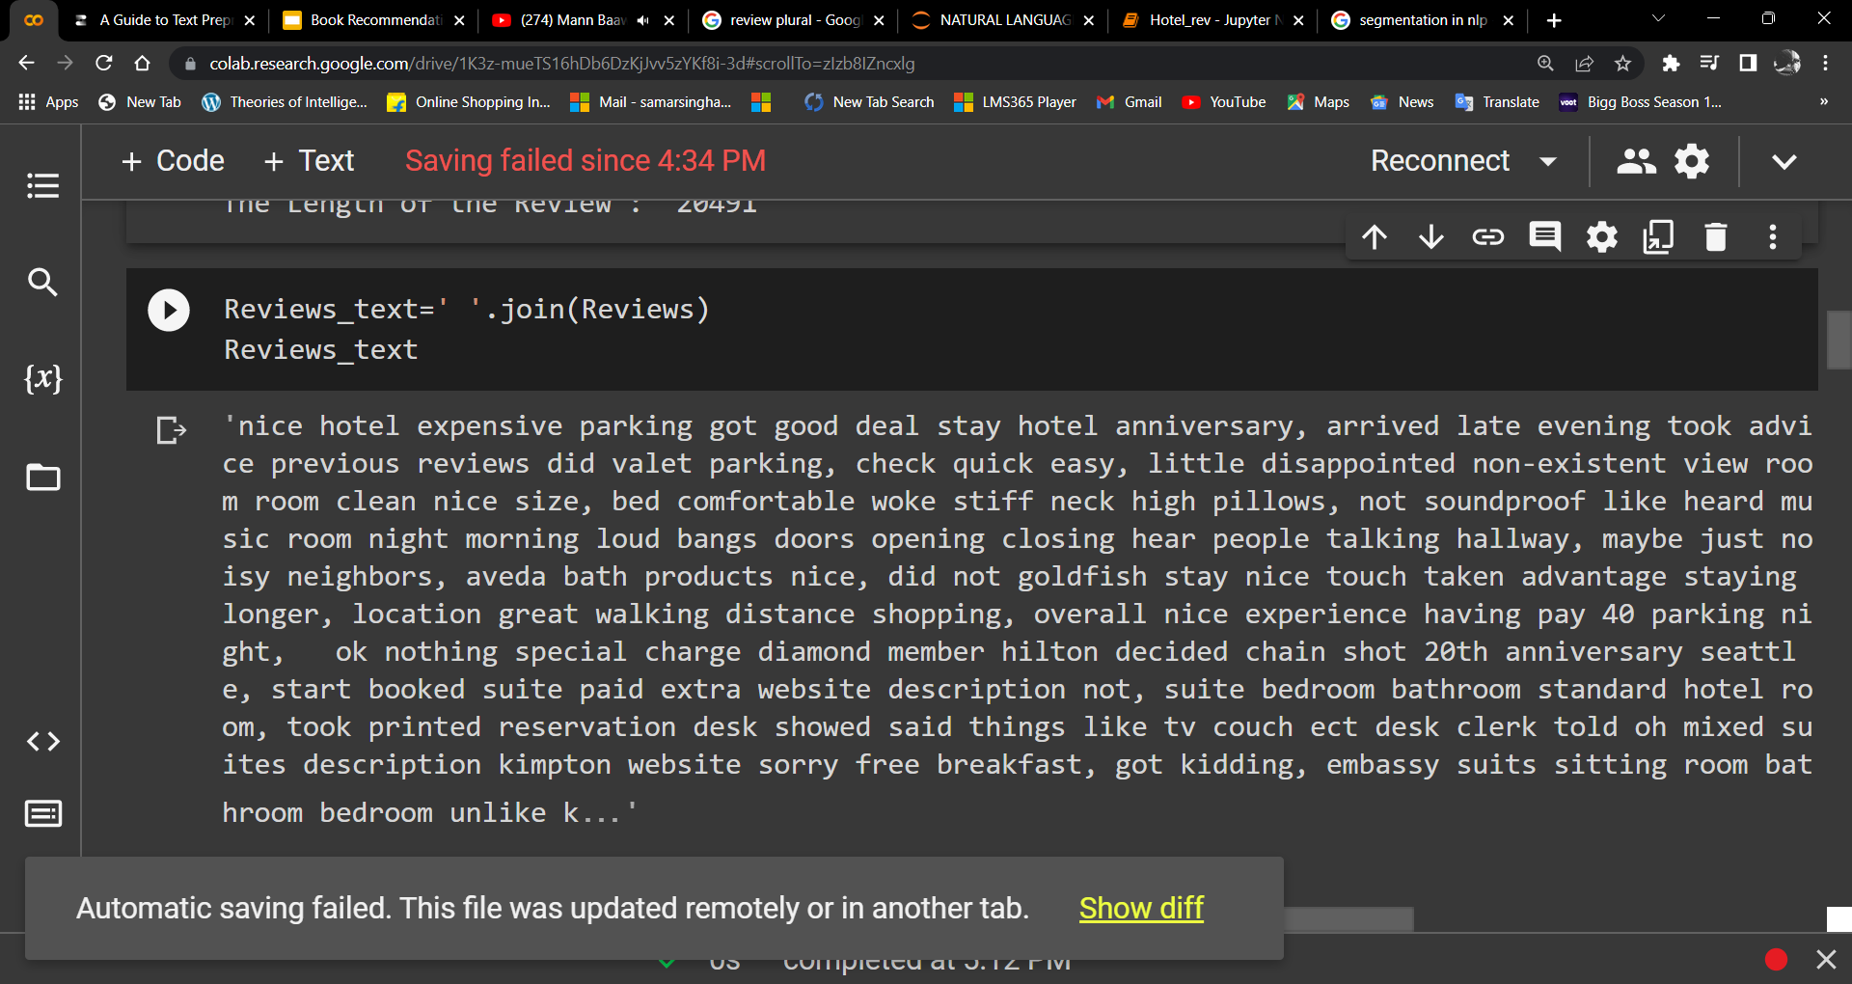
Segmentation: Segmentation involves breaking up text into corresponding sentences

Slide 12
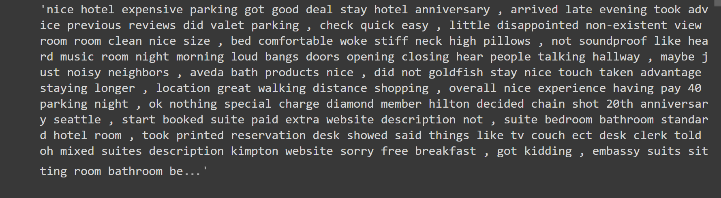
Tokenization: The tokenization stage involves converting a sentence into a stream of words, also called “tokens.” Tokens are the basic building blocks upon which analysis and other methods are built.

Slide 13
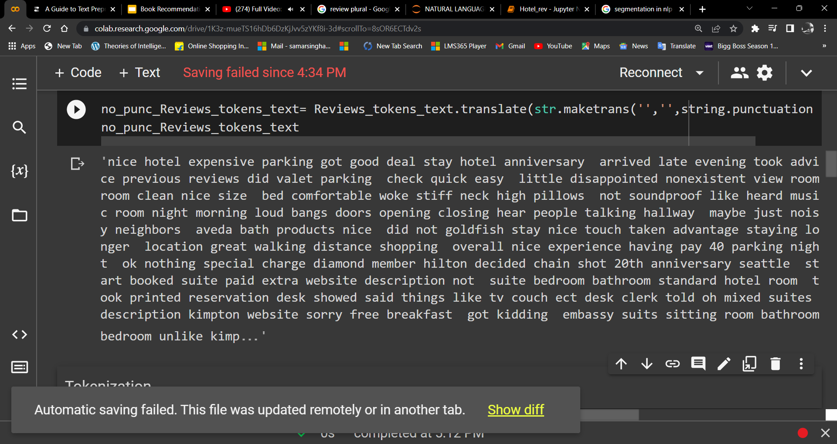
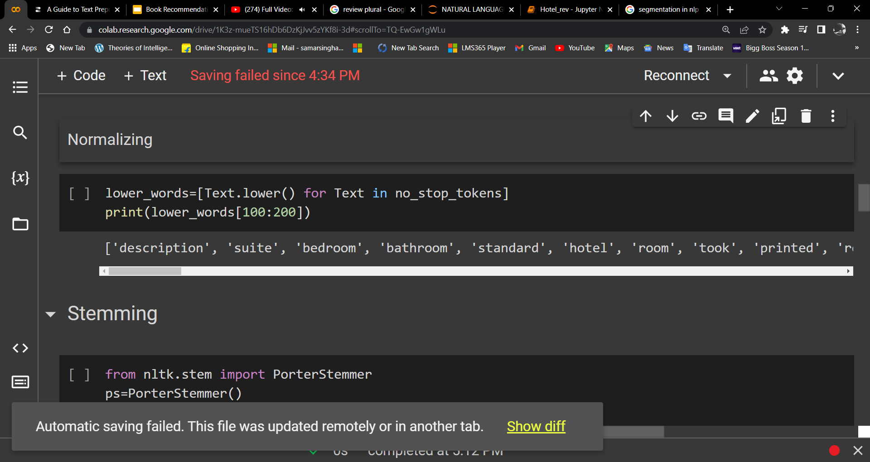
Remove Punctuation:
Normalization:

Slide 14
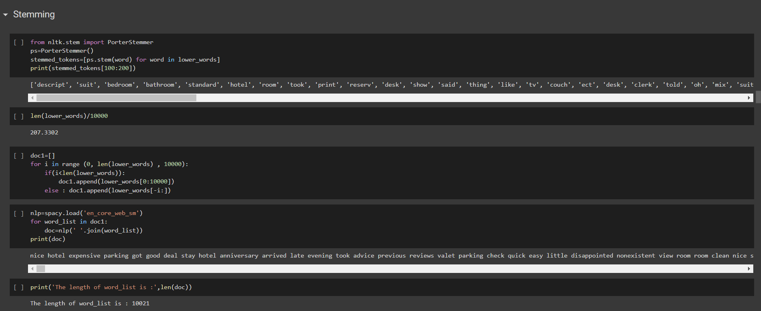
Stemming: The term word stem is borrowed from linguistics and used to refer to the base or root form of a word.

Slide 15
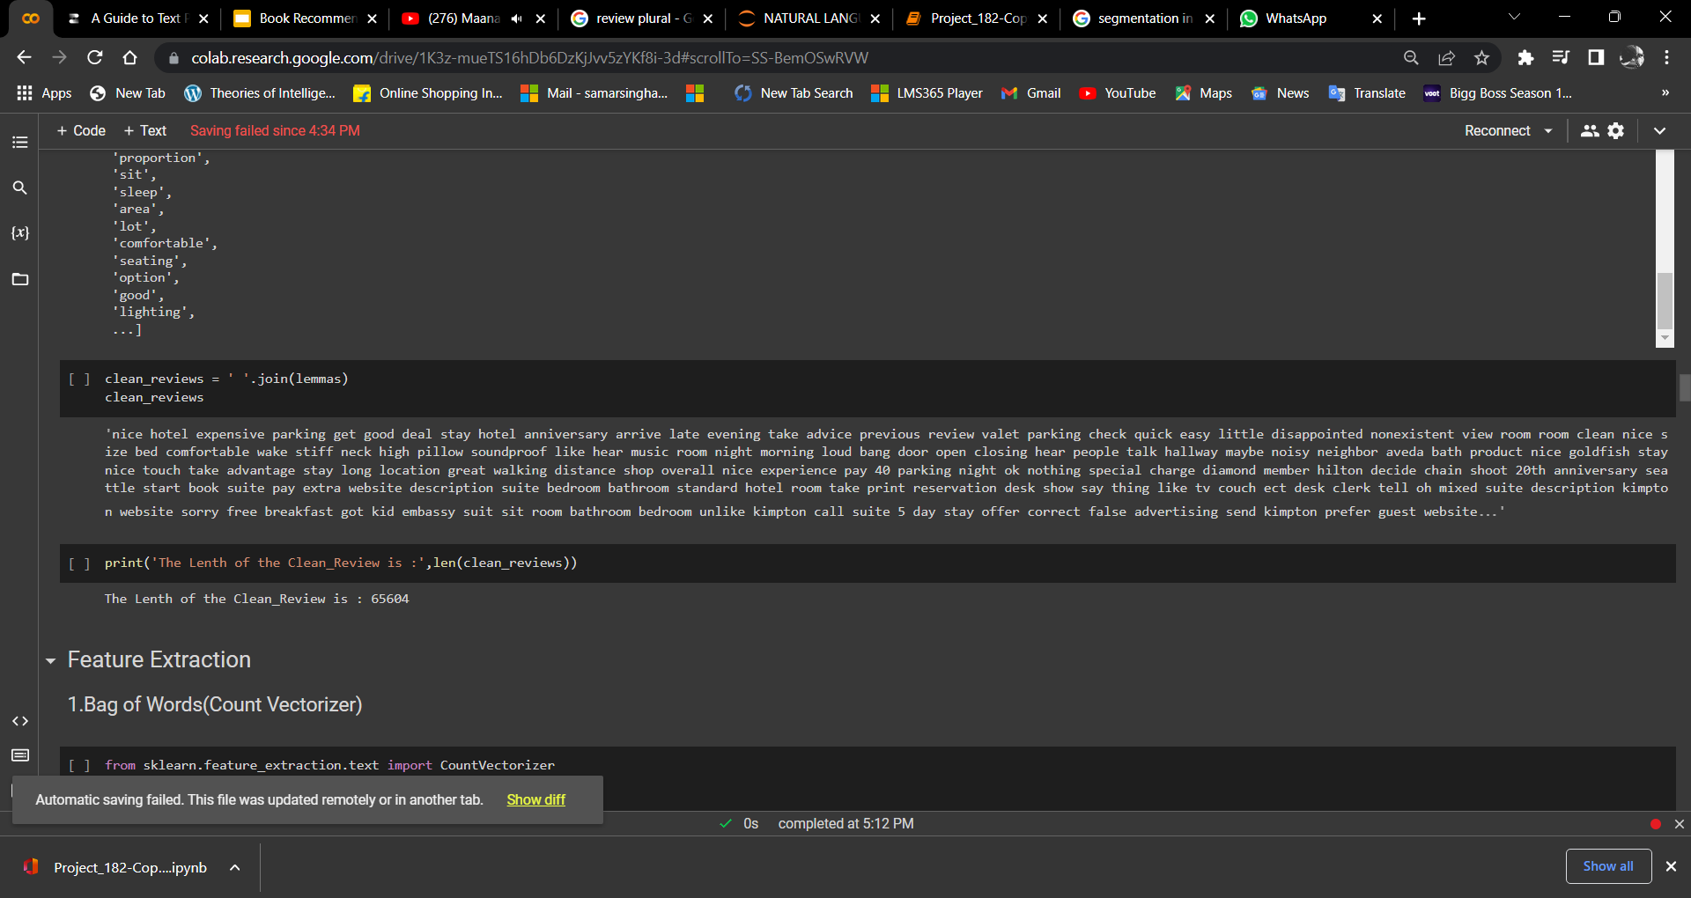
Lemmatization: Lemmatization is a more advanced form of stemming and involves converting all words to thecorresponding root form, called “lemma.

Slide 16
Feature Extraction

Slide 17
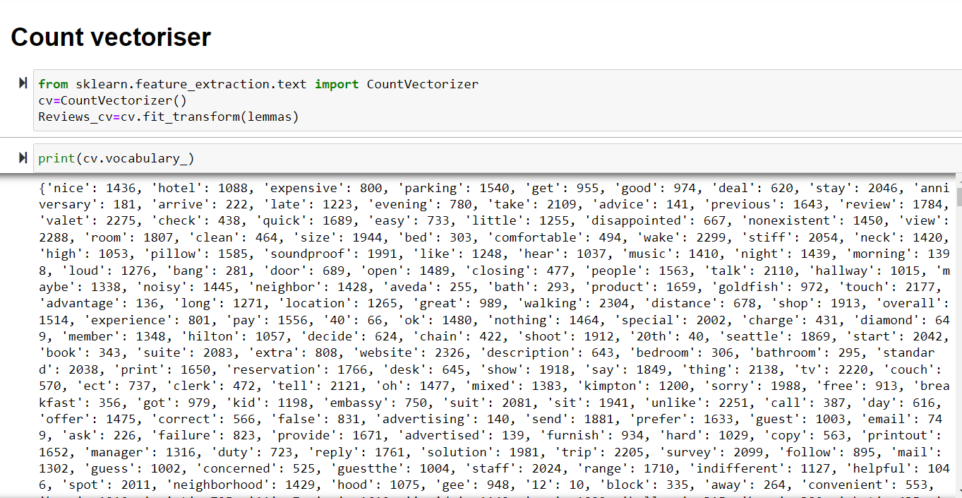
1.Bag of Words(Count Vectorizer)

Slide 18
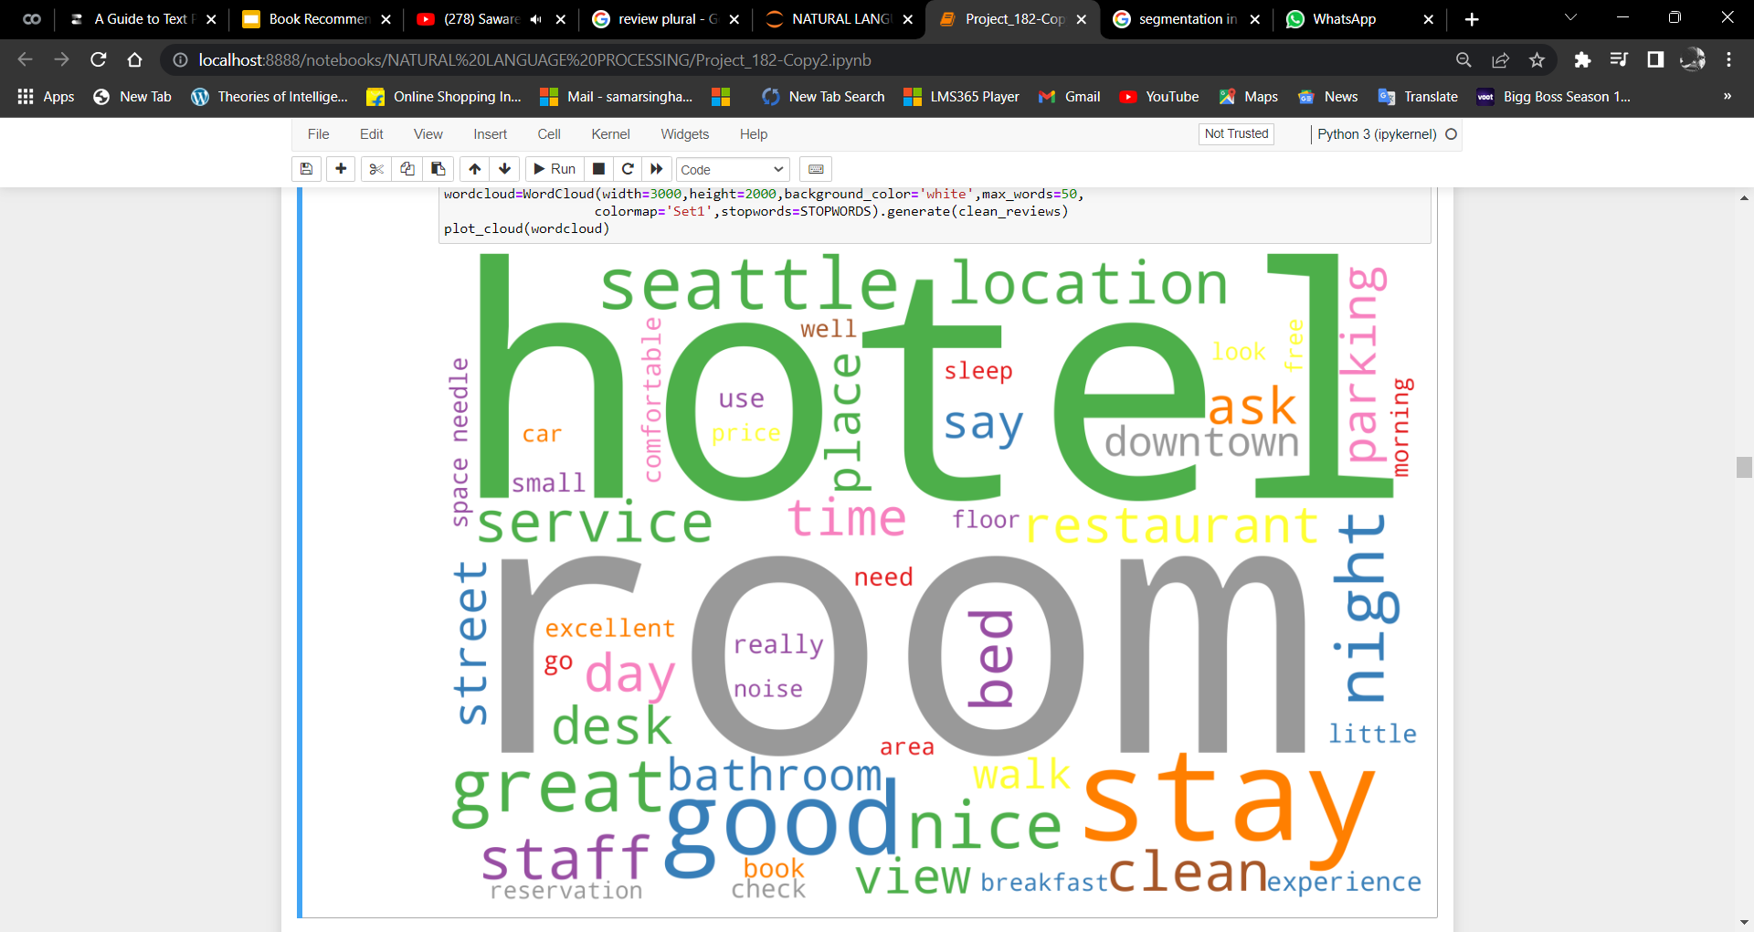
Word Cloud A data visualization technique used for representing text data in which the size of each word indicates its frequency or importance

Slide 19
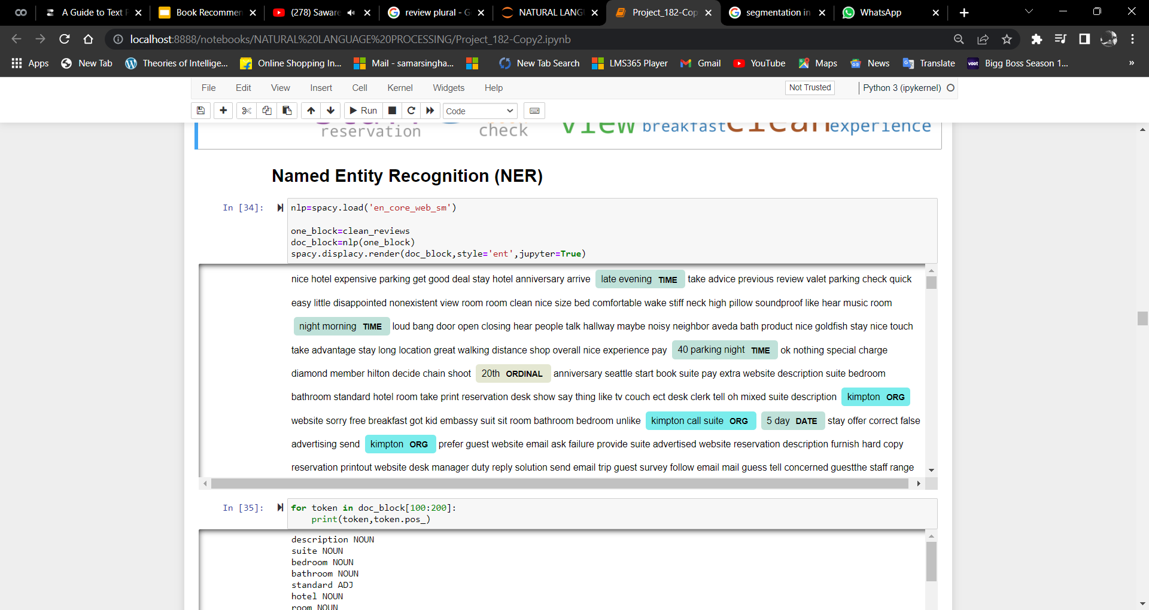
Named Entity Recognition: (NER) identifies features of interest - such as names of people, places and organizations, in addition to dates, currency and other special categories of nouns - within language data

Slide 20
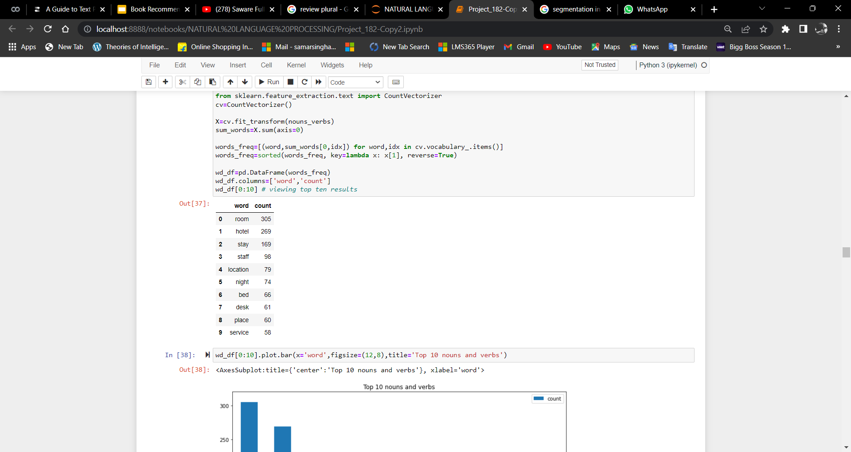
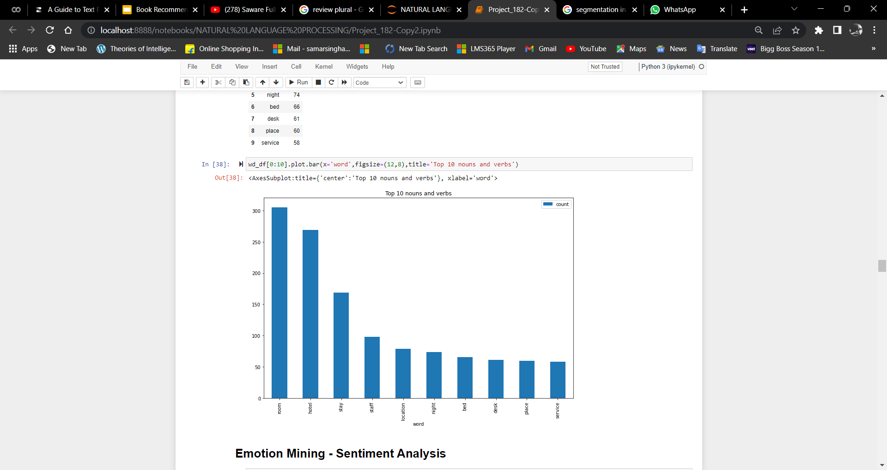
Counting the Noun and Verbs in the Text

Slide 21
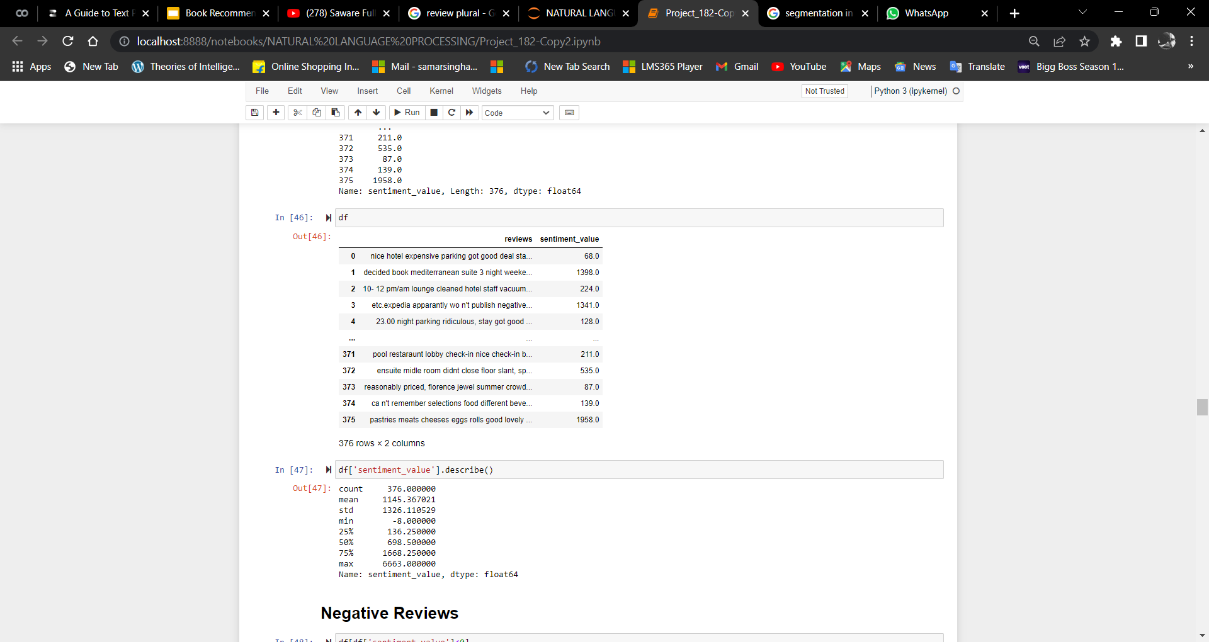
Emotion Mining - Sentiment Analysis: Identifies the emotional tone behind a body of text

Slide 22
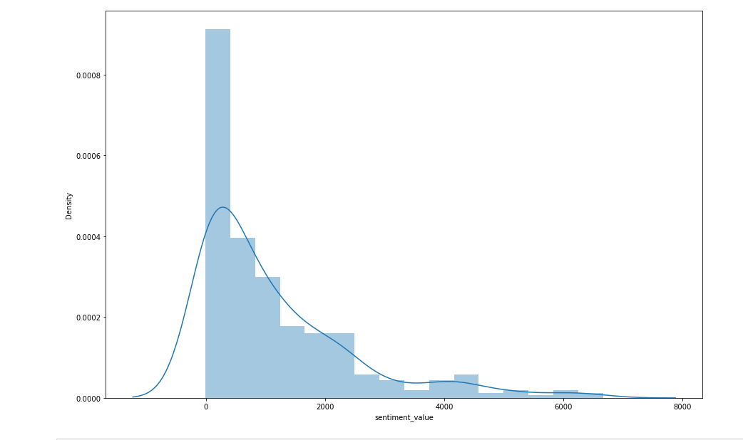

Slide 23
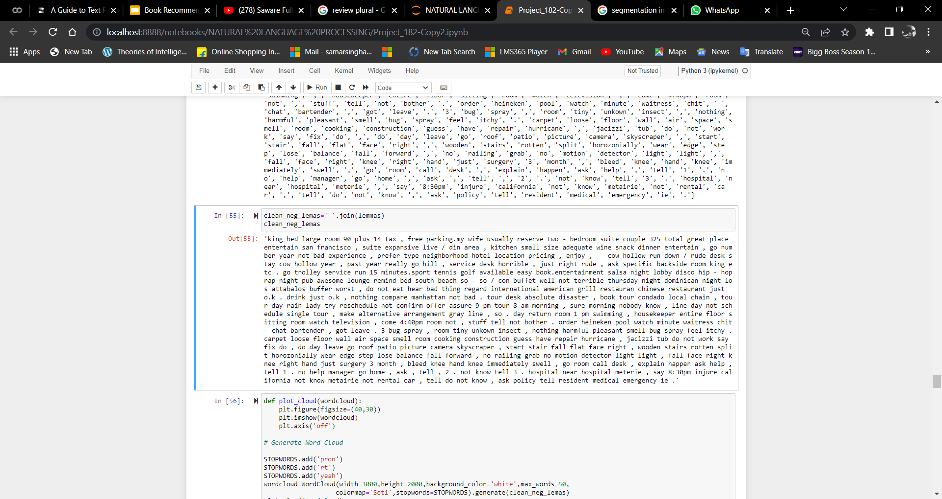
Negative Reviews:

Slide 24
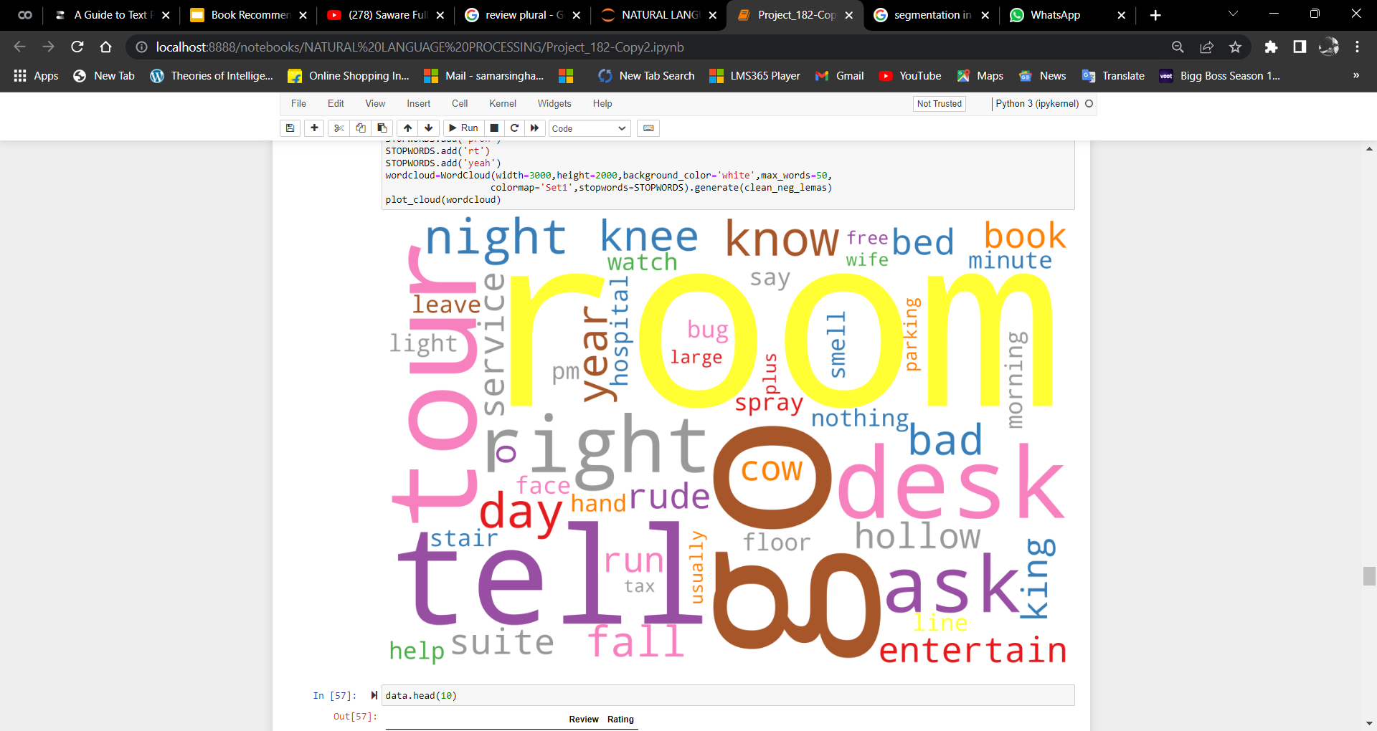
Word Cloud

Slide 25
MODEL BUILDING 1.LOGISTIC REGRESSION 2.RANDOM FOREST CLASSIFIER 3.NAIVE BAYES 4.SVC 5.KNN

Slide 26
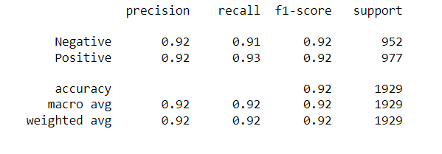
1.LOGISTIC REGRESSION

Slide 27
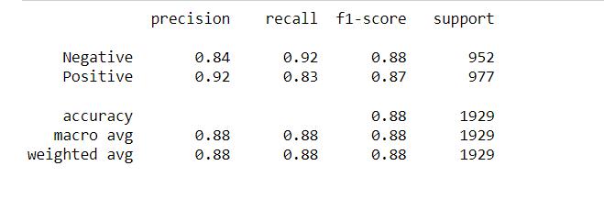
2.RANDOM FOREST CLASSIFIER

Slide 28
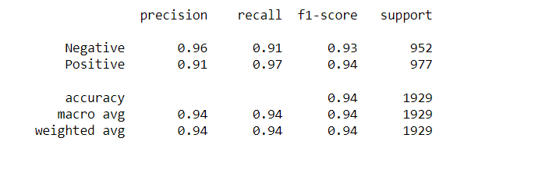
3.NAIVE BAYES

Slide 29
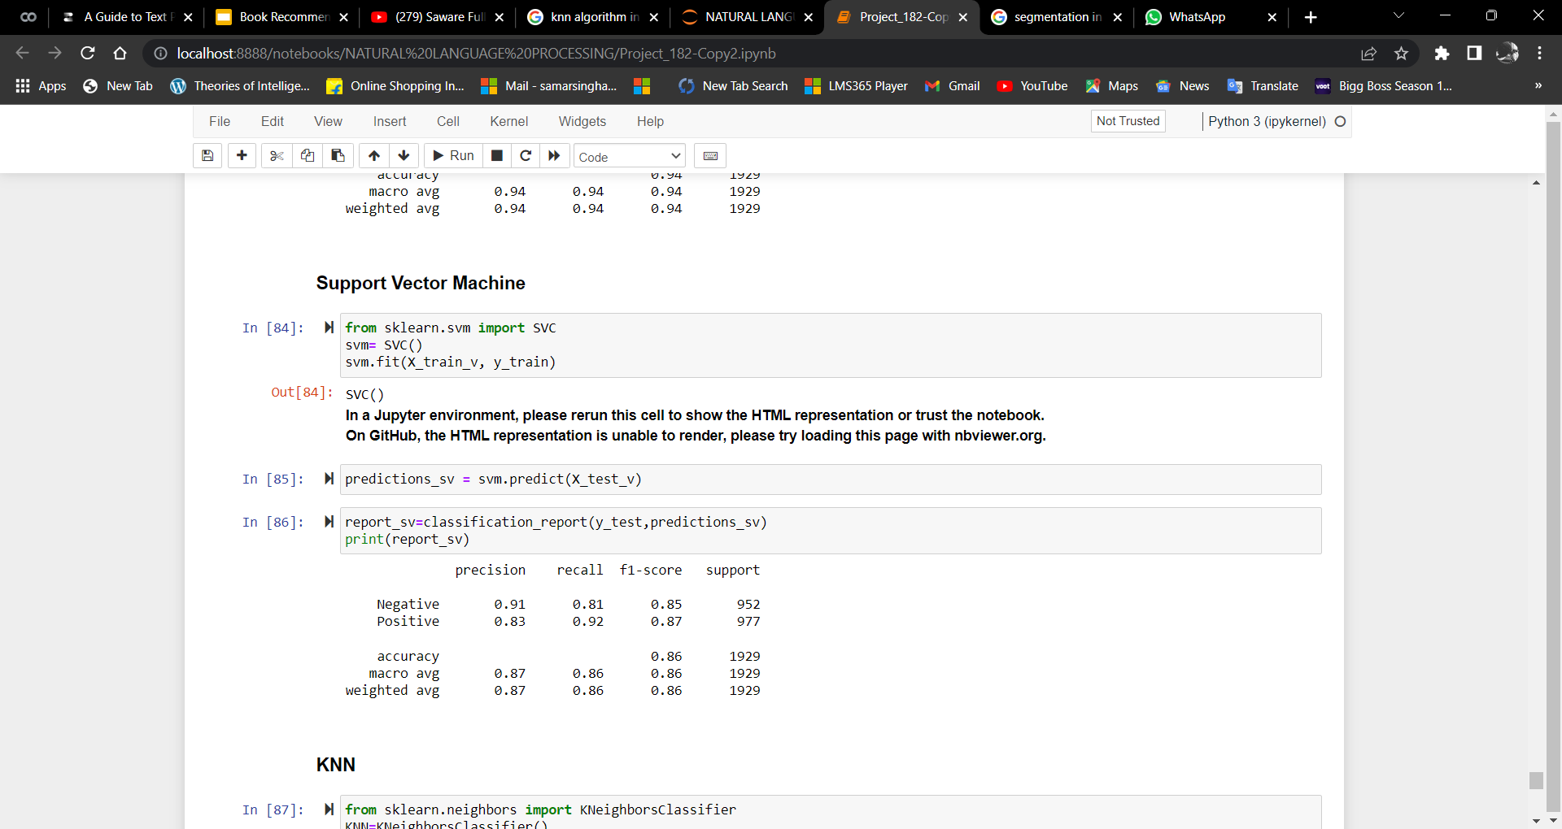
4.SVC

Slide 30
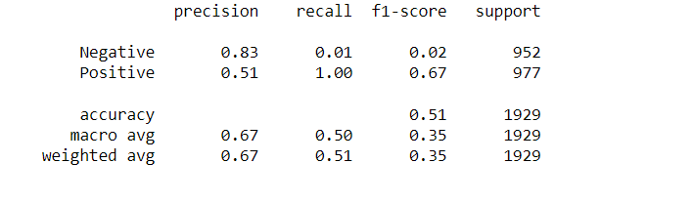
5. K-Nearest Neighbors

Slide 31
“Final model is Naive Bayes with 94% acc.“
Model | Accuracy
1.LOGISTIC REGRESSION | 0.92
2.RANDOM FOREST CLASSIFIER | 0.88
3.NAIVE BAYES | 0.94
4.SVC | 0.86
5. K-Nearest Neighbors | 0.51

Slide 32
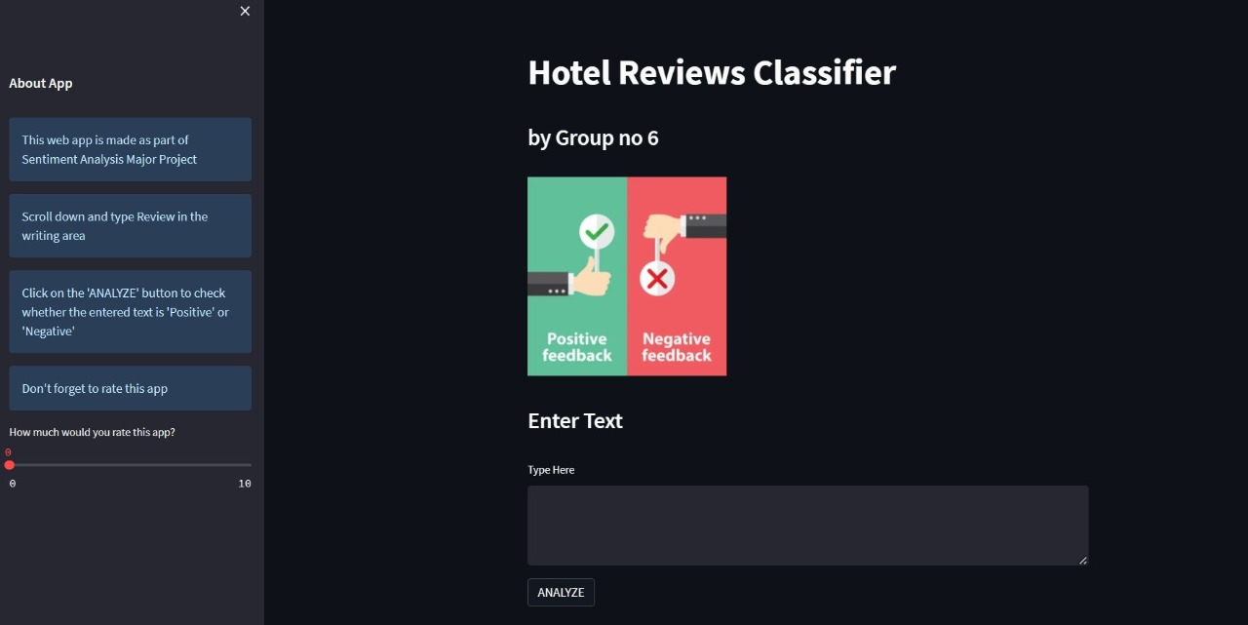
DEPLOYMENT →The Deployment is done using Streamlit:

Slide 33
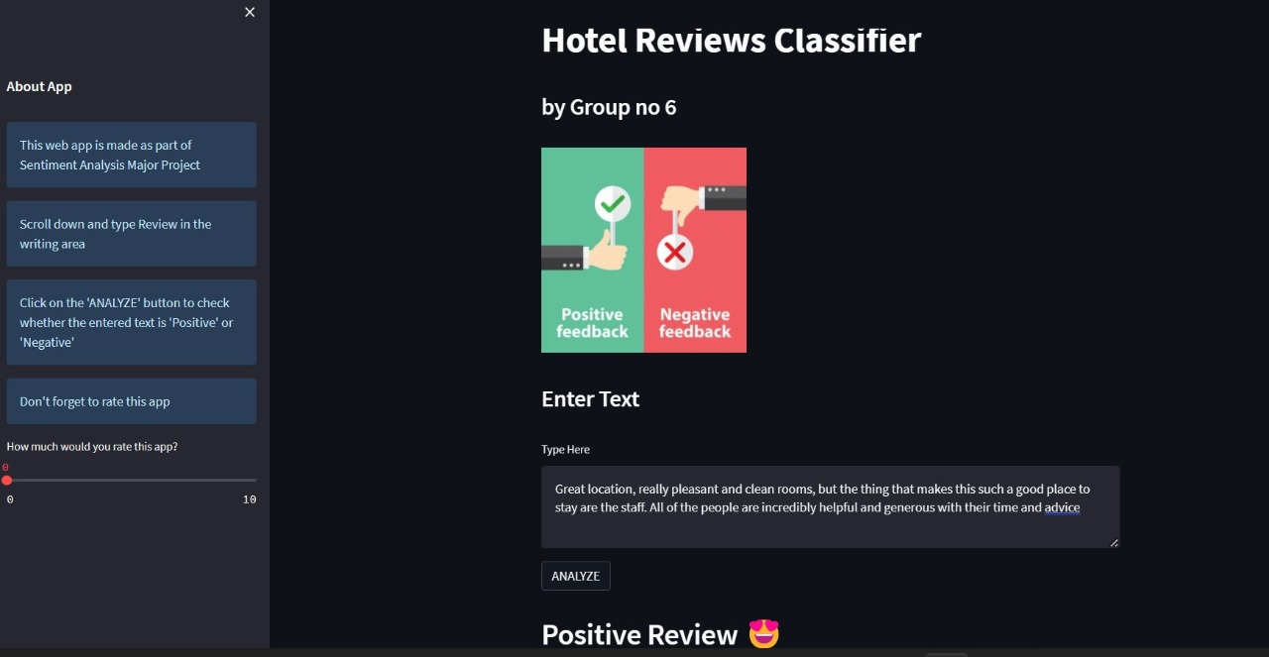

Slide 34
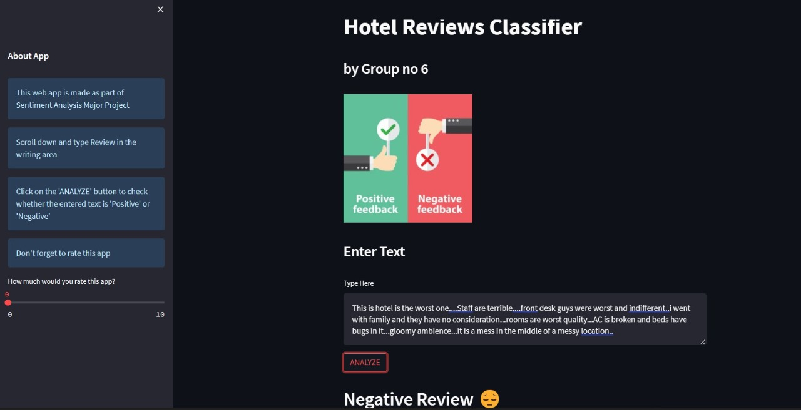

Slide 35
------------------------ Thank You ---------------------------

